Slide 1
Wearable Tattoo
By: Jakub Glebocki, Joshua Huff, Akshaj Arora

Slide 2
Introduction
This is a device in which you are able to control your mouse from touching capacitive sensors
These capacitive sensors can be put on skin(wearable) or any surface you like. We decided to incorporate ours on a snap bracelet
Communication is over bluetooth and therefore you can be away from the device which you plan on controlling, but you need to be within a reasonable range.

Slide 3
Purpose
Make controlling your pointer at the tip of your finger tips… wirelessly
This will be beneficial to people with disabilities who for example have Spinal Cord Injury, or any other disabilities which limit human mobilization
Hopefully this device will aid these people and make their life easier. Just pair it up and you can control your pointer from your laptop, in a cool exciting way

Slide 4
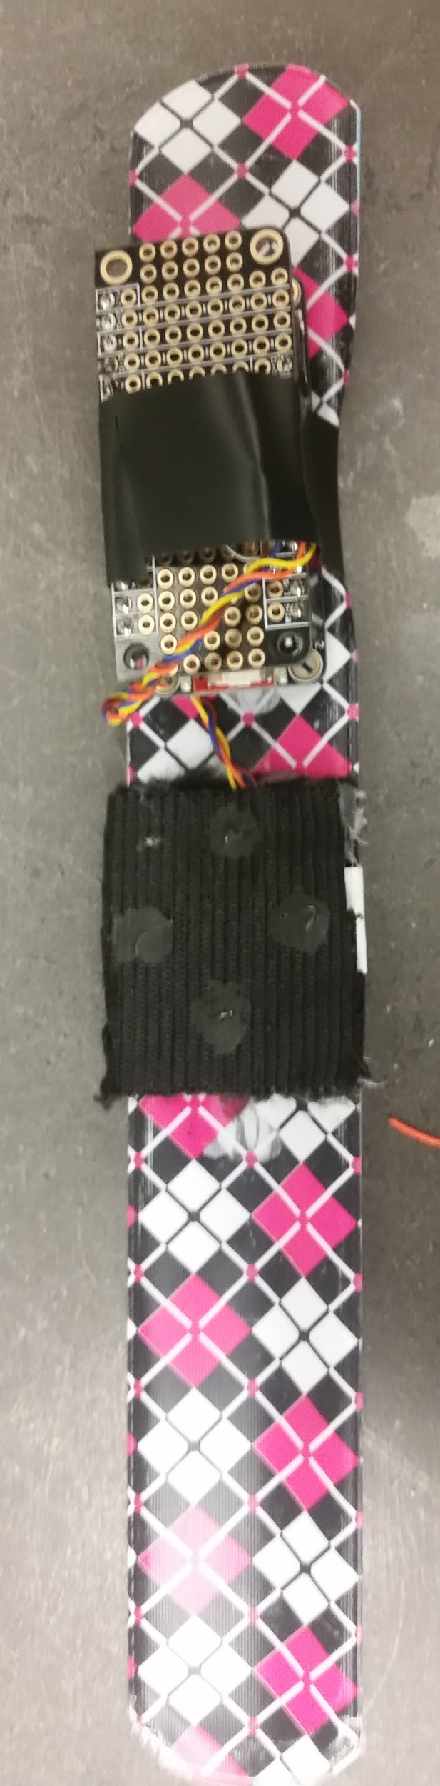
Device Construction
The device is constructed on to a snap bracelet
Because the electric paint is so brittle the capacitive sensor could not be paint directly on the snap bracket. The reason for this is when the bistable bracelet changes shape the paint would flake off.
So a fabric was used to hold the capacitive sensor on the bracelet.

Slide 5
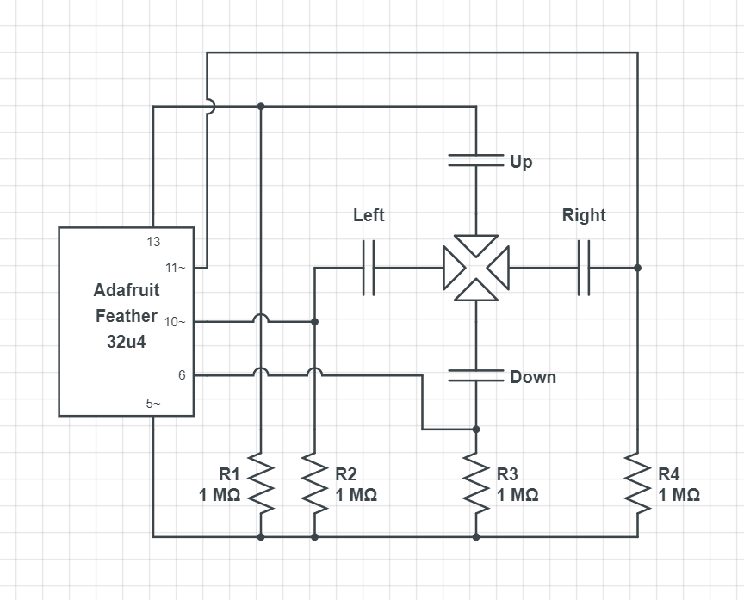
Circuit Diagram
Pin 5~ is the send pin
Pin 6, 10~,11~,13 are the receive pin
Pin 6 = Depad Down
Pin 10~ = Depad Left
Pin 11~ = Depad Right
Pin 13 = Depad Up

Slide 6
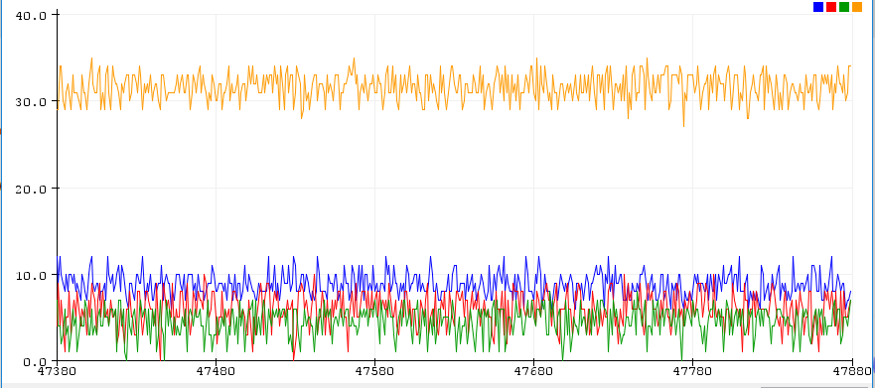
Processing
Noise
Signal Processing to determine threshold for given command
Blue = Up Green = Left Red = Right Yellow = Down

Slide 7
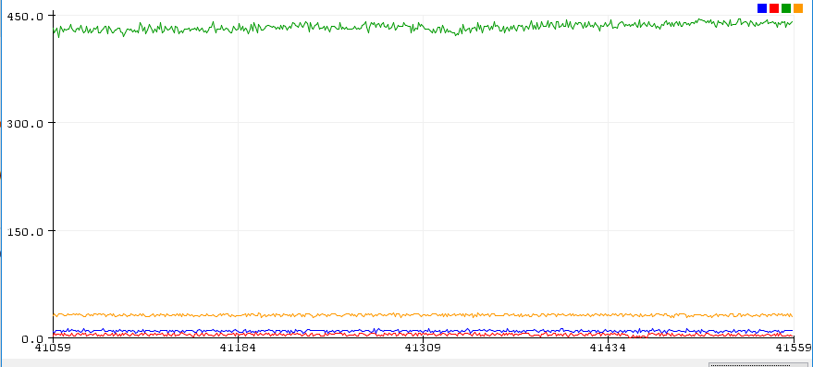
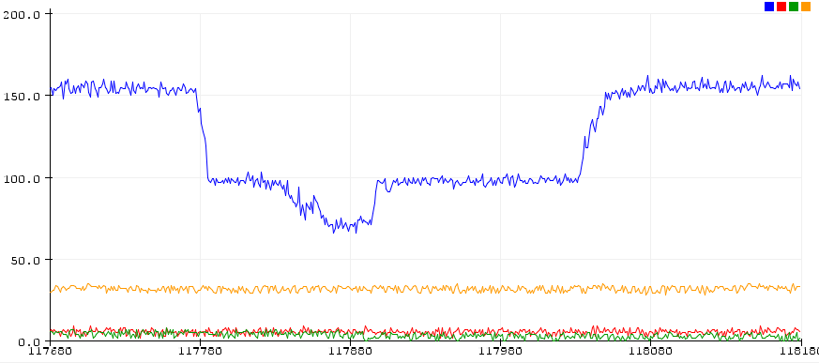
Processing Cont.
Left being pressed Maximum Possible Threshold ≅ 440
Up being pressed
Maximum Possible Threshold ≅ 60

Slide 8
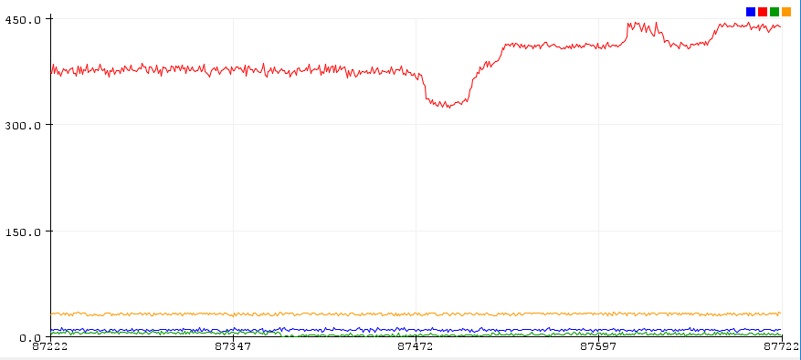
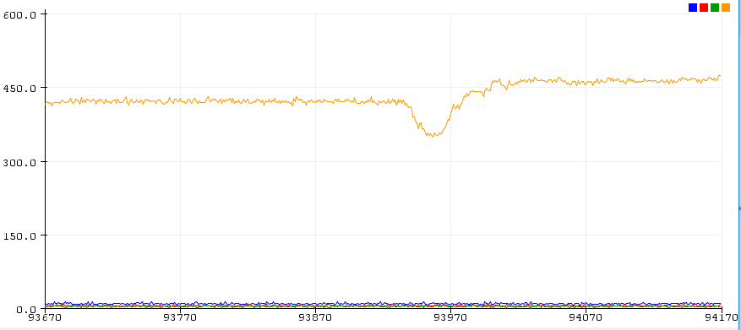
Processing Cont.
Right being pressed Maximum Possible Threshold ≅ 300
Down being pressed Maximum Possible Threshold ≅ 320

Slide 9
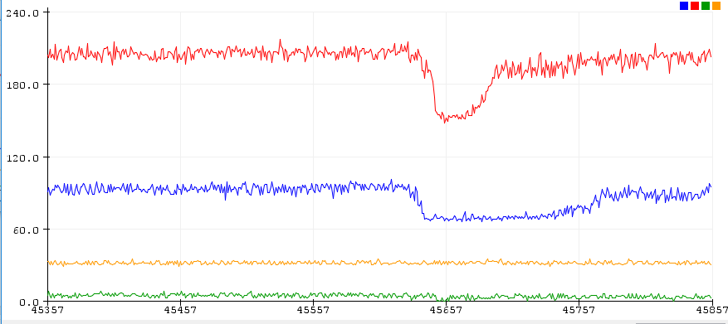
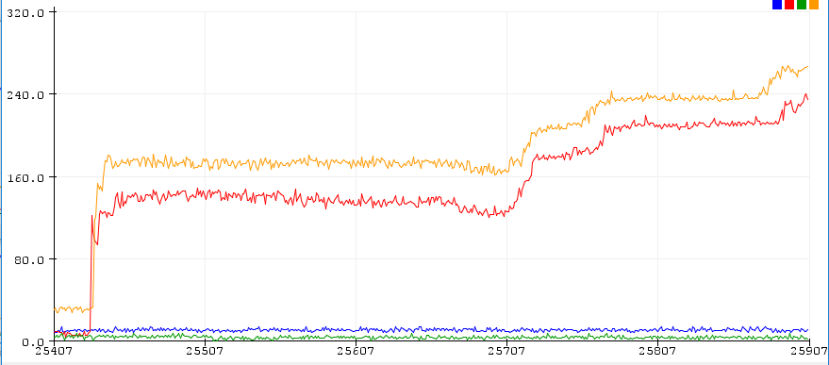
Processing Cont.
Input of two signals to make a diagonal movement
Up-Right (Diagonal) Up Maximum Possible Threshold ≅ 60 Right Maximum Possible Threshold ≅ 130
Down-Right (Diagonal) Down Maximum Possible Threshold ≅ 160 Right Maximum Possible Threshold ≅ 140

Slide 10
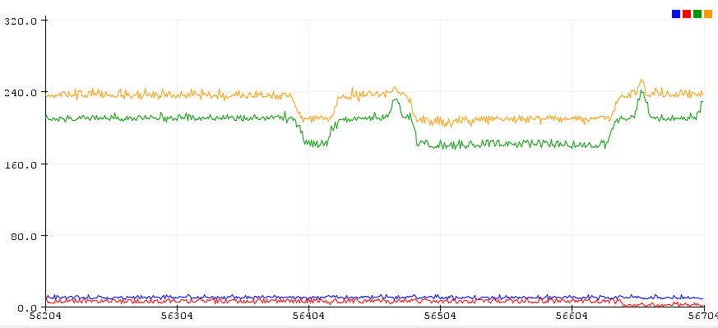
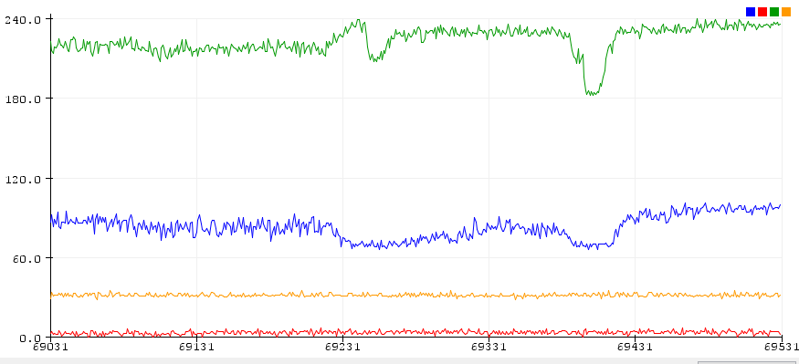
Processing Cont.
Down-Left (Diagonal) Down Maximum Possible Threshold ≅ 200 Left Maximum Possible Threshold ≅ 160
Up-Left (Diagonal) Up Maximum Possible Threshold ≅ 60 Left Maximum Possible Threshold ≅ 180

Slide 11
Arduino Code for Mouse Movement
void loop(void){ Serial.println(F("x,y = ")); long start = millis(); long total1 = cs_5_13.capacitiveSensor(30); long total2 = cs_5_11.capacitiveSensor(30); long total3 = cs_5_10.capacitiveSensor(30); long total4 = cs_5_6.capacitiveSensor(30); Serial.print("***"); // delay a bit delay(50);
if(total1 > 20 && total4 < 50){ ble.println(F("AT+BleHidMouseMove=0,-15")); //Up } if(total2 > 50 && total3 < 50){ ble.println(F("AT+BleHidMouseMove=15,0")); //Right } if (total3 > 50 && total2 < 50){ ble.println(F("AT+BleHidMouseMove=-15,0")); // Left } if (total4 > 50 && total1 < 20){ ble.println(F("AT+BleHidMouseMove=0,15")); //Down }

Slide 12
Arduino Code for Left Click
To incorporate a left when the device has only a depad We made use off the unused combination of left and right press at the same time.
The delay had to lower to below 100ms as it would be impossible to be double click otherwise.
if (total2 < 50 && total3 < 50){ ble.sendCommandCheckOK(F("AT+BleHidMouseButton=0")); // Left and Right off } if (total2 > 50 && total3 > 50){ ble.sendCommandCheckOK(F("AT+BleHidMouseButton=L,press"); // Left and Right on } }

Slide 13
Drawbacks
The use of one power pin for 4 capacitive sensor will cause reduction in signal strength if more than one sensor is touch at a time.
The brittleness of the electrical paint make using it on surfaces that change shape difficult.
The delay had to be dropped so the device can be able to double click but this can cause the device to run choppy.
Could implement more features in the future for the mouse
Changing power supply from the USB mini to 3.7v battery changes the thresholds so the device incompatible with battery power.

Slide 14
Conclusion
Have this device be wearable and bluetooth connected decreases all the messy wire connections that would come along with it.
Our team hope’s to aid those with disabilities to improve easibility and comfort in using their computer/mouse.

Slide 15
Thank You

